Slide 1
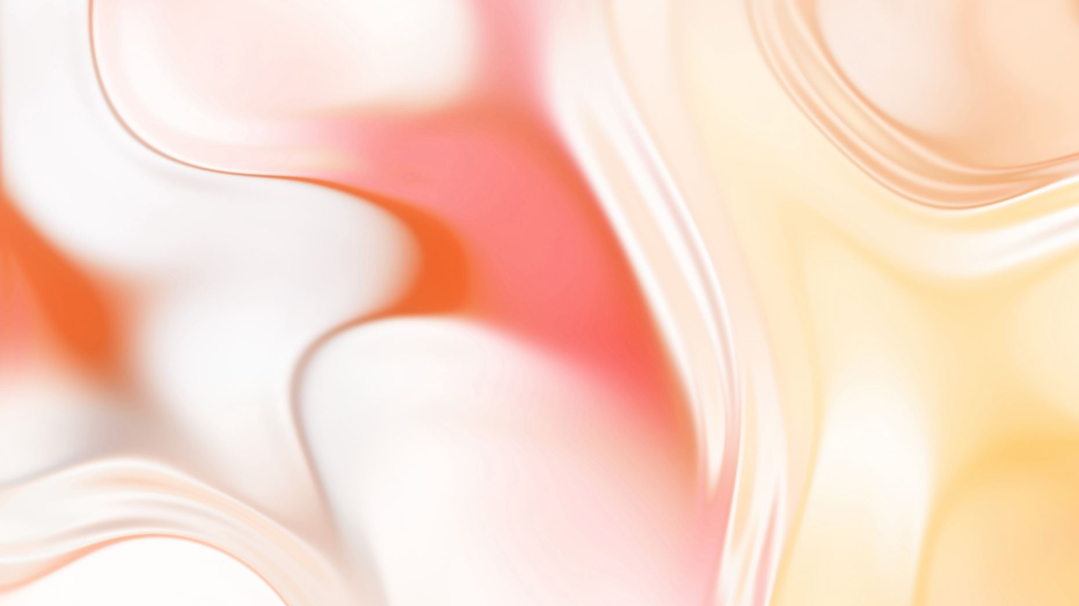
Reverend Insanity: Gu World

Slide 2
More Rank nine is the limit in the whole world, it is the highest summit, this world cannot have rank ten, so rank nine is the strongest!The Gu world is divided into five major regions, namely Southern Border, Western Desert, Northern Plains, Eastern Sea, and Central Continent. Their name denotes their general direction in the Gu world with Northern Plains being in the north, Southern Border being in the south, and so forth. Alone Northern Plains has an area of roughly 5,000,000,000 km² (5 billion km²)[1] while Southern Border has an area of roughly seven to eight times the size of the earth (between 3.5 billion km² and 4.0 billion km²)[2]. The size of central continent is unknown, but it is stated to be 50,000,000 km wide [3], which depending on its shape (square/circle), means its size ranges from 1,97 to 2,5 quadrillion km². It is not explicitly stated how large the other regions are. Each region possesses a regional wall as well as distinct Heaven and Earth Qi.Furthermore, the Gu world possessed nine heavens at one point of time but only two exist in the current time period, namely black heaven and white heaven. Black heaven’s and white heaven’s positions alternate during night and day.[4] To enter them one has to go through the heavenly wind qi wall which, similar to the regional walls, separates the two remaining heavens from the five regions.The Gu world is inhabited by humans, variant humans, beasts, and plants.AdvertisementDao VeinsHeaven had heaven veins, earth had earth veins, and humans had human veins. The so-called vein was extraordinary and special, not only was it an agglomeration of dao marks, but it also contained the characteristics of movement.They could be of every path, like water path or fire path, heaven path or earth path or human path...Heaven veins might be formless, but they contained abundant heaven path dao marks. At the same time, these heaven path dao marks were not constantly unchanging, they circulated and transformed continuously. So when the dao veins of the world merged and the difference in qi concentration of the five regions created qi tides, every time they dissipated there would be qi harvest fruits, an agglomerate of qi at the new concentration, different from that of all the previous five regions, wich could aid in the process of converting the qi of an immortal aperture in the new concentration.And in the two heavens, because almost all the grotto-heavens were placed on a heaven vein node, the qi harvest fruits’ emergence became even more obvious, turning into a calamity that sucked the heaven and earth qi of the grotto-heaven.The Ten EarthsWhen the earth veins of the five regions merged they created many unique terrains. The people in the world called them the ten earths. They are Earth Abyss, Earth Trench, Earth Tunnel, Earth Cave, Earth Prison, Production Earth, Flying Earth, Formation Earth, Treasure Earth, and Tomb Earth.Flying Earth has the shape of a small island and it can move around in the earth vein as quickly as flying, its speed cannot be matched normally.Earth Tunnel is a great and complicated ant nest-like tunnel that can excavate entire mountains.Tomb Earth is shaped as a burial mound. On the peak of the burial mound is a tombstone, having writings of «Tomb of name of the Gu Immortal». Gu Immortals could revive using this tomb earth. At the moment of revival the dao marks preserved would show on the surface of the burial mound and be absorbed by the Gu Immortal.Treasure Earth contained all types of resources long gone extinct.AdvertisementRegional WallsThe Dao veins of each region are separated the qi of the five regions vary, so, like the water that goes from a higher ground to a lower one, qi tides are formed between the regions, creating a regional wall. Every Region is surrounded by a regional wall that separates the region from the other adjacent regions. The walls seem to extend all the way up to black heaven and white heaven, as well as far beneath the earth and have a certain range/thickness that extends quite some way.The heaven and earth qi of the five regions vary. Thus, when Gu Immortals go to different regions, absorbing the heaven and earth qi there would cause problems in their immortal aperture. This is also why Gu Immortals often have to return to their region to undergo tribulations. The difference in heaven and earth qi also caused the regional walls to form.When the five regional walls disappeared, the heaven and earth qi of the five regions converged into one, releasing qi tides in all the five regions.The list of regional walls are as follows:Region Regional Wall ColorCentral Continent Saint Regional Wall White-GoldenSouthern Border Miasma Regional Wall Deep PurpleEastern Sea Blue Water Regional Wall Dark BlueWestern Desert Raging Flame Regional Wall RedNorthern Plains Licorice Regional Wall GreenEvery human, variant human, plant, or beast born in the five regions, experiences a suppression based on their strength when passing a regional wall. The greater the strength or cultivation rank, the greater the suppression of the being, mortal gu masters generally experience less suppression that those of gu immortals. Mortal gu worms also experience suppression that lower their power by a level in comparison to their actual rank. This can be mitigated by refining the gu in the new region. Immortal Gu don’t experience suppression in foreign regions.If a Gu Immortal wants to travel from Southern Border to Central Continent they have to pass through at least two regional walls. To get from Southern Border to Northern Plains one has three possibilities by passing through Southern Borders regional wall and then passing through one of the three regional walls of the chosen region (Eastern Sea, Central Continent, or Western Desert) after that one has to pass another two regional walls, that of the region one chose as well as Northern Plains regional wall.The regional walls are ever-changing and have places where the suppression is weaker, making it easier to pass through them. The suppression is felt by the beings as having a hard time moving inside a regional wall. Gu Immortal’s immortal apertures can also be affected and their foundation sustaining damage especially when using Gu or killer moves.AdvertisementHeavenly Wind Qi WallThe heavenly wind qi wall is a wall made of qi that separates the five regions from the two remaining heavens. It can only be traversed using special qi path methods or by forcing one’s way through it, the latter requiring sufficient strength comparable to rank 8.TriviaTen Earths are mentioned in in Volume 4, translated as ‘ten depths’. Both ten depths and ten earths share the same Hanzi 十地.As it appears the Gu world is flat, as no one has been seen traversing from Western Desert directly to Eastern Sea or other similar situations (without using space path methods).It is unknown what is on the fringes and beyond the boundaries of the four outer regions.The suppression of beings inside the regional wall is unaffected by the being’s region of origin. A Southern Border Gu Immortal will experience roughly the same amount of suppression inside the Miasma Regional Wall as they would inside the Raging Flame Regional Wall or any other regional wall for that matter.It is unclear how the regional walls would affect a Gu Master that advanced to a Gu Immortal in black heaven or white heaven. As any being that was born in one of those two heavens isn’t affected by the regional walls’ suppressive effect.According to a Q&A celebrating ten years of Reverend Insanity, the growth of Gu World is facilitated by transmigrators (Otherworldly Demons) and Chaos. The same Q&A also confirmed that Gu World is all-embracing, such that foreign materials will be incorporated into gu world to fuel its growth.

